Slide 1

Predict Customer Response to Boost Marketing Campaign
Created by:
Muhammad Chosasih Mahendra
mchosasih@gmail.com
linkedin.com/in/mchosasih/
Click here to visit my portfolio.

Slide 2
Project Description
Personality-based marketing is a strategy that has gained popularity in recent years and is currently shaping the marketing industry. By gaining a deeper understanding of the ways specific personality traits influence purchasing decisions, businesses can design and launch more effective campaigns and establish stronger connections with prospective and current customers (Indeed). In this project, customer response is predicted using historical marketing campaign data to improve performance and target consumers that are right for the company. The focus of this project is to predict customers response.

Slide 3
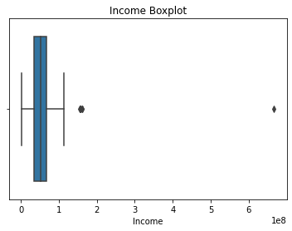
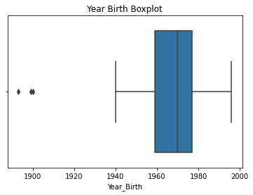


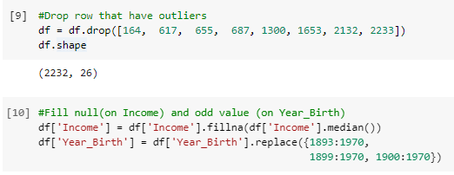
Data Cleaning & Pre-processing
Drop Unnecessary Columns
'Unnamed: 0' is removed because it is the index.
'ID' is removed because it is a unique value for consumers.
'Z_CostContact' and 'Z_Revenue' are removed because they only have 1 unique value.
Handle Outliers
The outliers in the Year of Birth column are manipulated. While outliers in the Income column are deleted, and the null value is filled in using the median value.
To see IPYNB file click here

Slide 4
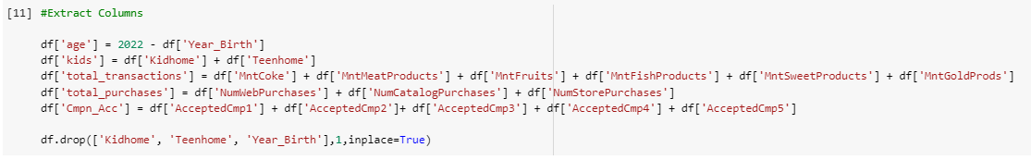
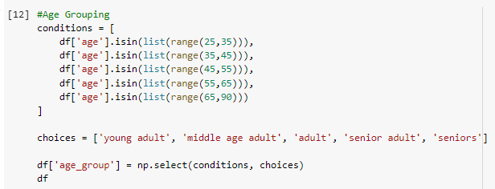


Data Cleaning & Pre-processing
Extract Columns
New Columns : Age, Kids, Total Transactions, Total Purchases, Total Campaign Accepted.
Grouping Age
Extract Membership Column
To see IPYNB file click here

Slide 5
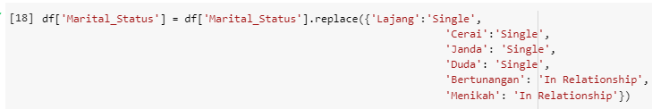
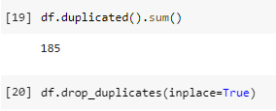
Data Cleaning & Pre-processing
Modify Marital Status
Change the value to only two categories to reduce complexity.
Delete Duplicate Value
To see IPYNB file click here

Slide 6
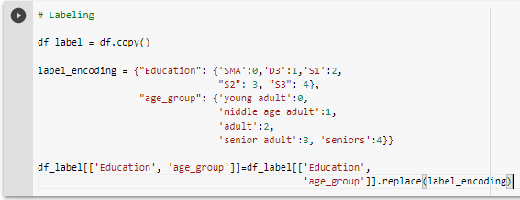
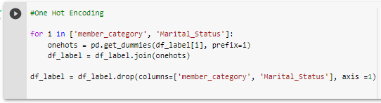
Data Cleaning & Pre-processing
Feature Encoding (Label)
Label encoding for categorical features of type ordinal.
Feature Encoding (One Hot Encoding)
One Hot Encoding for nominal type categorical features.
To see IPYNB file click here

Slide 7
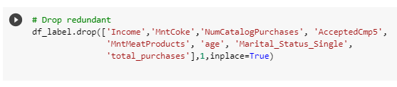
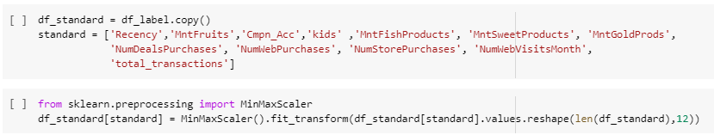
Data Cleaning & Pre-processing
Feature Selection
Delete high correlated feature ( > 0.7 ).
Standardization
Standardize numeric value data using MinMaxScaler.
To see IPYNB file click here

Slide 8

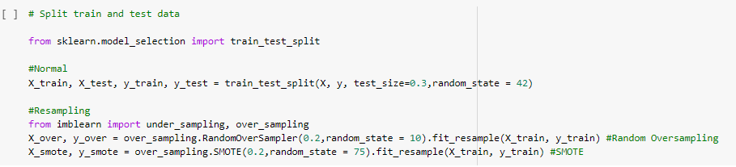
Data Modeling
Divide Feature & Target
Split Train Test
The data has imbalanced target features, so resampling is performed to prevent the model from being overfitted. Resampling methods used are Random Oversampling and SMOTE.
8
To see IPYNB file click here

Slide 9
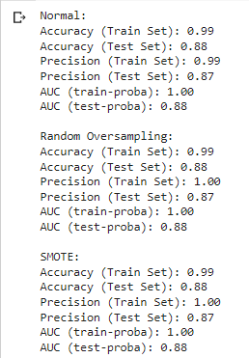
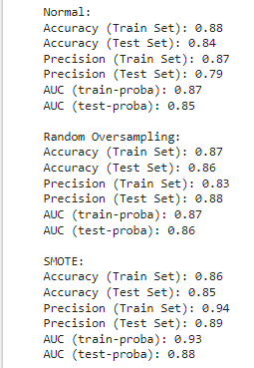
Data Modeling
Random Forest Classifier
Hyperparameter Tuning
The model looks overfit without using hyperparameter tuning.
With hyperparameter tuning, data modelling uses the Random Forest Classifier algorithm, whose best performance is data resampling with the SMOTE method.
9
To see IPYNB file click here

Slide 10
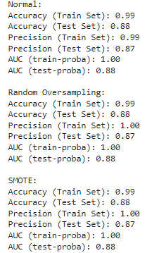
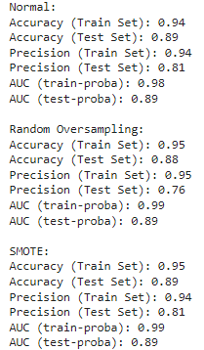
Data Modeling
XGBoost
Hyperparameter Tuning
Conclusion
So, the model used is:
Random Forest Classifier
SMOTE Resampling Method
Accuracy : 0.86 (train), 0.85 (test)
Precision : 0.94 (train), 0.89 (test)
Even after tuning the hyperparameters, data modelling using the XGBoost algorithm still doesn't perform well
The model looks overfit without using hyperparameter tuning.
10
To see IPYNB file click here

Slide 11
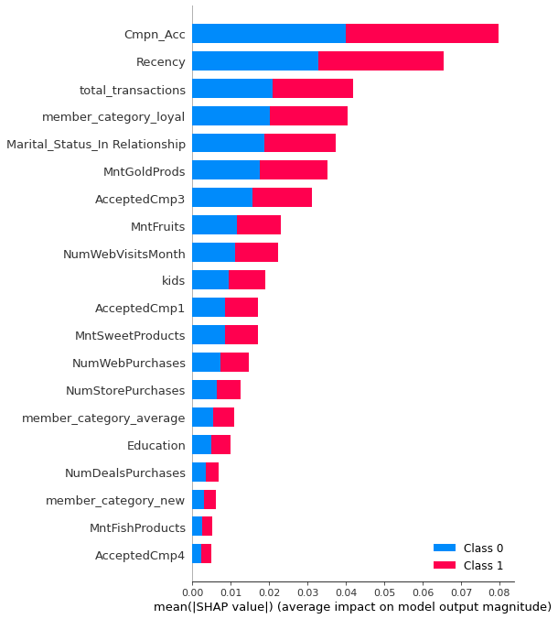
Explain The Model With SHAP
Summary Plot
The five most influential features of the model are:
Cmpn_Acc : Number of previous campaigns with positive responses.
Recency: The time the consumer made the last purchase.
total_transactions : Total purchase value of all types of groceries.
member_category_loyal : Consumers who fall into the loyal category (> 9.4 years per 2022)
Marital_Status_In Relationship : The marital status of the consumer has a partner.
To see IPYNB file click here

Slide 12
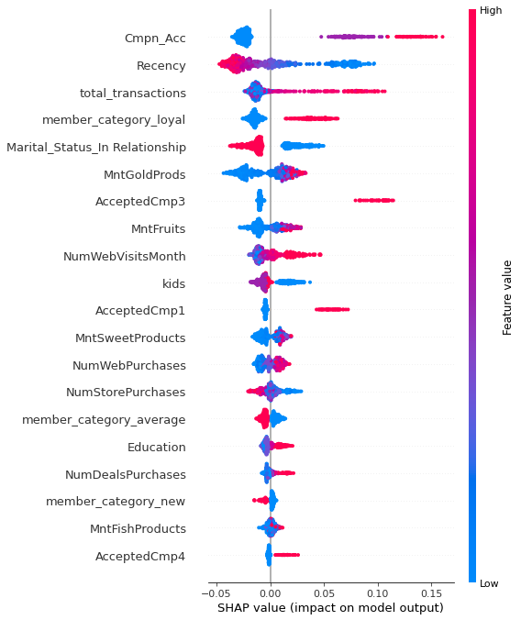
Explain The Model With SHAP
Features Effect to Classification Labels
Campaign Accepted
The more often consumers respond positively to previous campaigns, it has a positive effect on Response 1 (Positive Label).
Recency
The longer the distance between the last purchase by consumers, it has a positive effect on Response 0 (Negative Label).
Total Transactions
The higher the number of consumer transactions, it has a positive effect on Response 1(Positive Label).
Loyal Member
If the consumer is in the loyal category (>9.4 years per 2022), it has a positive effect on Response 1 (Positive Label).
In Relationship
If the consumer has a partner, it has a positive impact on Response 0 (Negative Label).
To see IPYNB file click here

Slide 13
Thanks!
Created by:
Muhammad Chosasih Mahendra
mchosasih@gmail.com
Linkedin.com/in/mchosasih
Click here to visit my portfolio.

